Slide 1
HADOOP ECOSYSTEM

Slide 2
Hadoop ecosystem
Hadoop Ecosystem is a platform or a suite which provides various services to solve the big data problems. It includes Apache projects and various commercial tools and solutions. There are four major elements of Hadoop i.e. HDFS, MapReduce, YARN, and Hadoop Common. Most of the tools or solutions are used to supplement or support these major elements. All these tools work collectively to provide services such as absorption, analysis, storage and maintenance of data etc.

Slide 3
Components of hadoop ecosystem
HDFS: Hadoop Distributed File System
YARN: Yet Another Resource Negotiator
MapReduce: Programming based Data Processing
Spark: In-Memory data processing
PIG, HIVE: Query based processing of data services
HBase: NoSQL Database
Mahout, Spark MLLib: Machine Learning algorithm libraries
Solar, Lucene: Searching and Indexing
Zookeeper: Managing cluster
Oozie: Job Scheduling

Slide 4
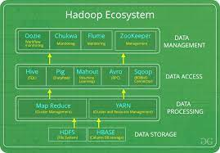

Slide 5
END

